Slide 1
Evaluation of 5G Open Radio
Access Network
Simulation Environments
Research Project
M.Sc. Communication Systems and Networks
Cologne University of Applied Sciences
Supervisor:
Professor Dr. Andreas Grebe
Faculty of Information, Media and Electrical Engineering.
Cologne university of applied sciences.
E-Mail: andreas.grebe@th-koeln.de
Presentor:
Md Nur Mohammad
Masters in Communication systems and Networks.
Matriculation:11145131
E-Mail: md_nur.mohammad@smail.th-koeln.de
Timeline: October 2022 – August 2023

Slide 2
Contents
Work Flow
Introduction.
Software Community.
O-RAN Architecture.
RAN Intelligent Controller.
RIC-Environment Setup and Deployment
Connection Setup.
Testing.
Future opportunities.
Conclusion.
References.

Slide 3
Work Flow
Studied 5G Core and Open Radio-Access Network.
  5G Core Network.
To Investigate Open-source Plattform.
  O-RAN Alliance and Software Community.
    O-RAN Architecture and Release Notes.
Followed Releases.
  All Releases with Specifications.
    G-Release
Instructions and Interfaces.
  RIC Components.
  Related Interfaces.
Deep Dive in Deployment
  Installed Required Dependencises.
    Kubernetes, Helm, Docker etc.
  Deployed Components.
Estabilished Connection.
  Introduced ONAP.
  Created Policy.
Testing and Analysis Packets.
  Wireshark.
Conclusion.

Slide 4
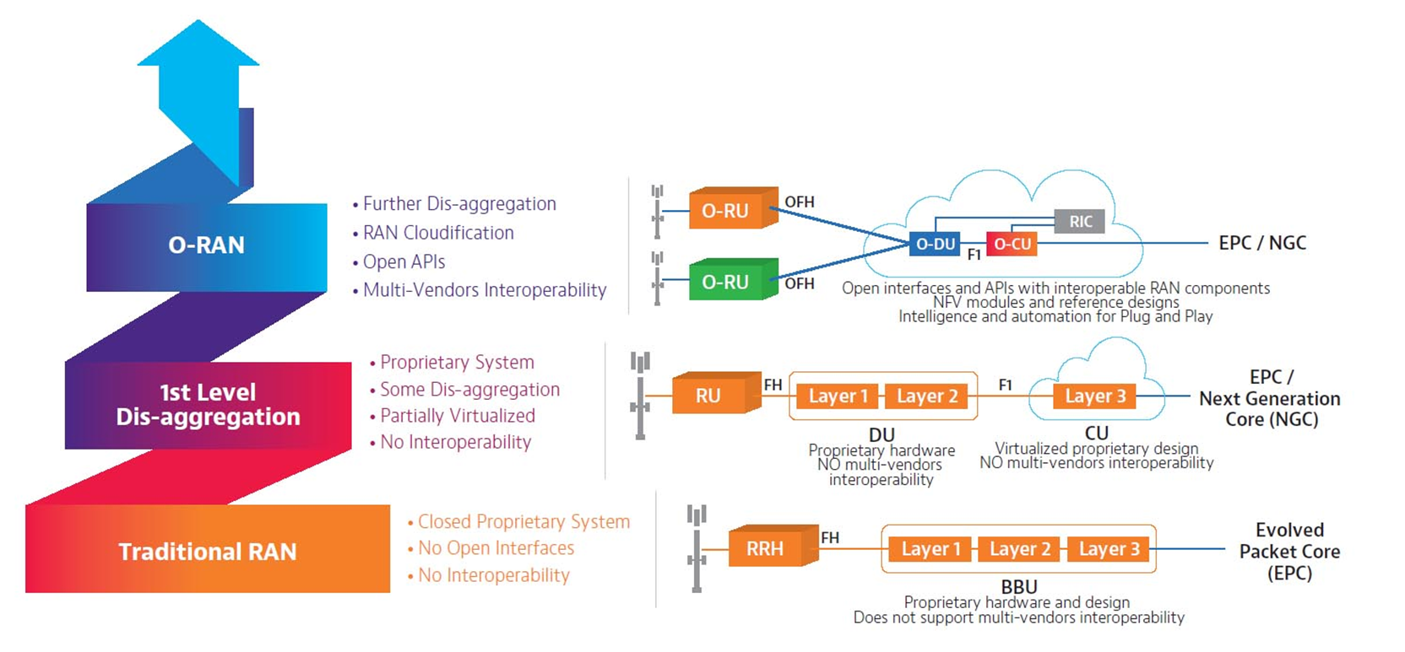
Open Radio Access Network (O-RAN)
Source: https://www.o-ran.org/

Slide 5

Software Community
World-Wide Community.
Mission is to Re-Shape the Industry.
Supports its Members in Several Areas.
Link: https://www.o-ran.org/

Slide 6
O-RAN Alliance Releases
A Release (Amber release) >>Release date: November 2019
B Release (Bronze Release) >>Release date: Jun 2020
C Release (Cherry Release) >> Release date: December 2020
D Release (Dawn Release) >>Release date: July 2021
E Release (Emerald Release) >>Release date: December 2021
F Release >>Release date: July 2022
G Release>> Release date: December 2022
H Release >> Release date: July 2023
Website: https://wiki.o-ran-sc.org/display/ORAN/O-RAN+Software+Community

Slide 7
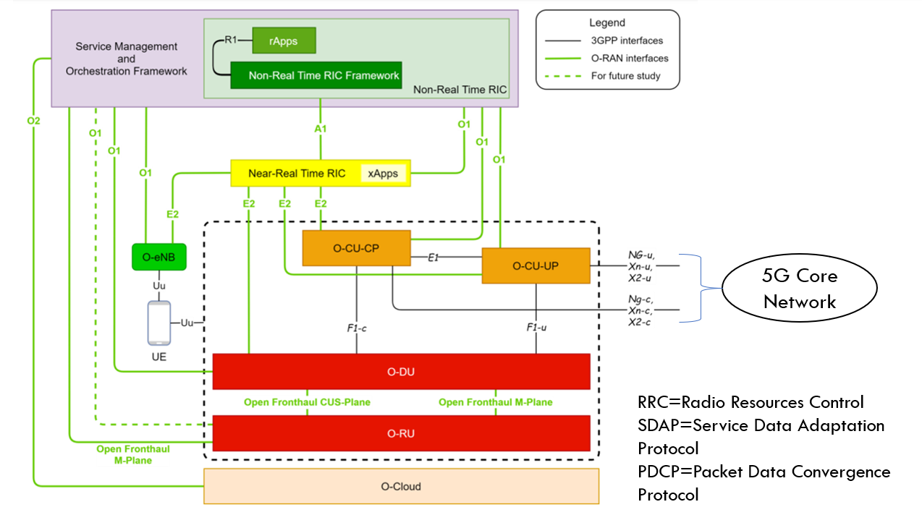
Logical Architecture of Open RAN

Slide 8
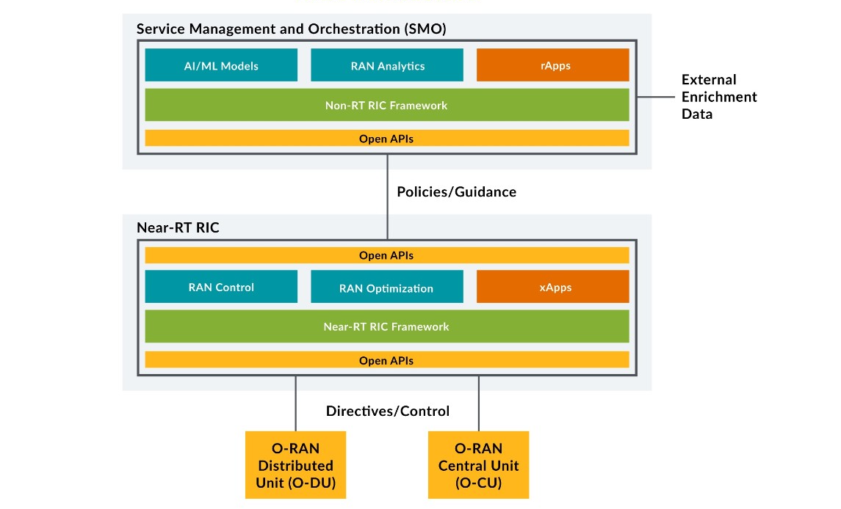
Ran Intelligent Controller Architecture

Slide 9
Near-Real-time RIC X-APPs (RICAPP) (E2 interface)
Requirements
Linux(Ubuntu 20.04)
With (Minimum 4CPU & 16GB RAM)
Kubernetes 1.16
Helm 3.9
X-APPs Frameworks
C++
Go
Python

Slide 10
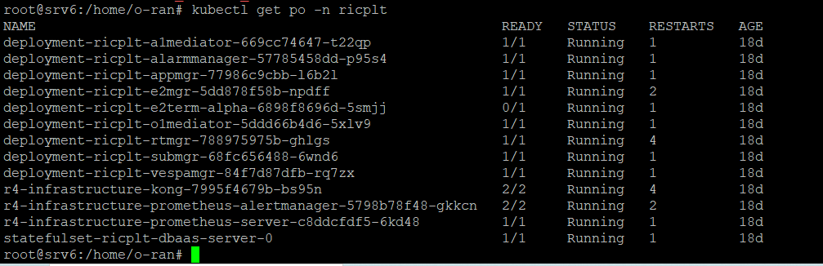
Near-RT-RIC Pods Deployment

Slide 11
Non-Real-time RIC (A1 & R1 Interfaces) (NONRTRIC)
Requirements
Linux(Ubuntu 20.04)
With (Minimum 8CPU & 32GB RAM)
Kubernetes 1.26
Helm 3.9
r-APPs Frameworks
C++
Java
Python

Slide 12
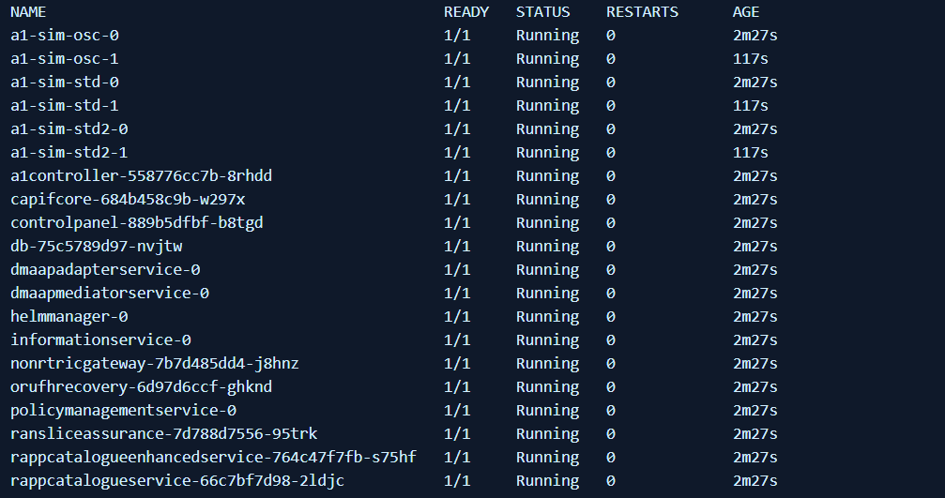
NON-RT-RIC Pods Deployment

Slide 13
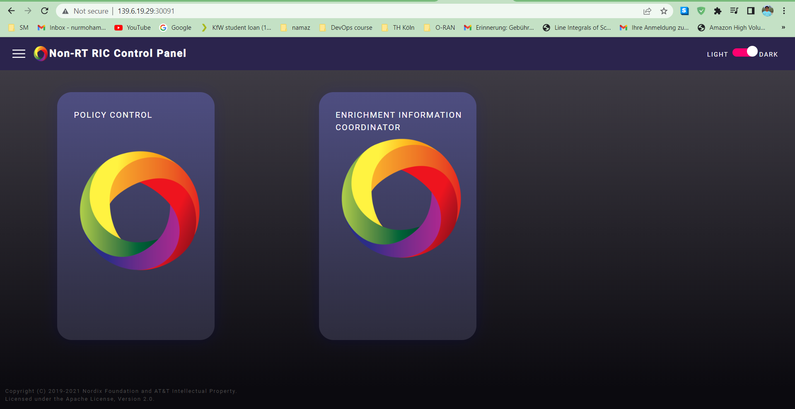
Control Panel of Non-RT RIC

Slide 14
Connection Setup
Assign External IP to near and non RT RIC Services.
Edit application_configuration.json file (non-rt-ric).
ONAP Components Installation.
Replace policy_schema_ratecontrol.json file with Policy Control file.

Slide 15
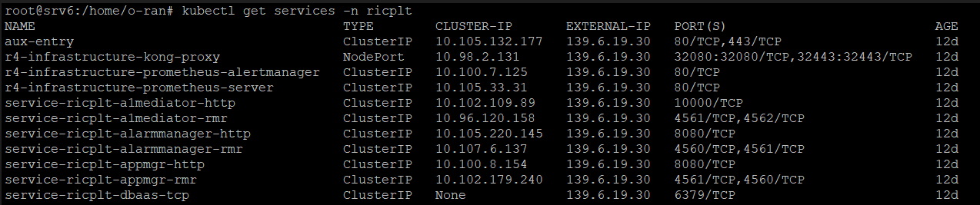
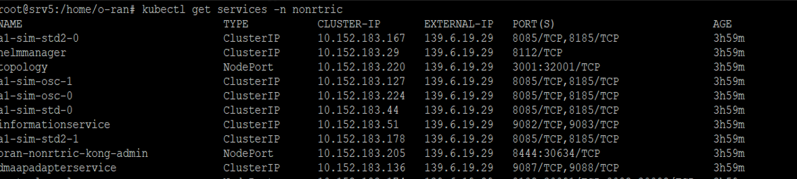
Assing External IP
Near-RT-RIC
Non-RT-RIC

Slide 16
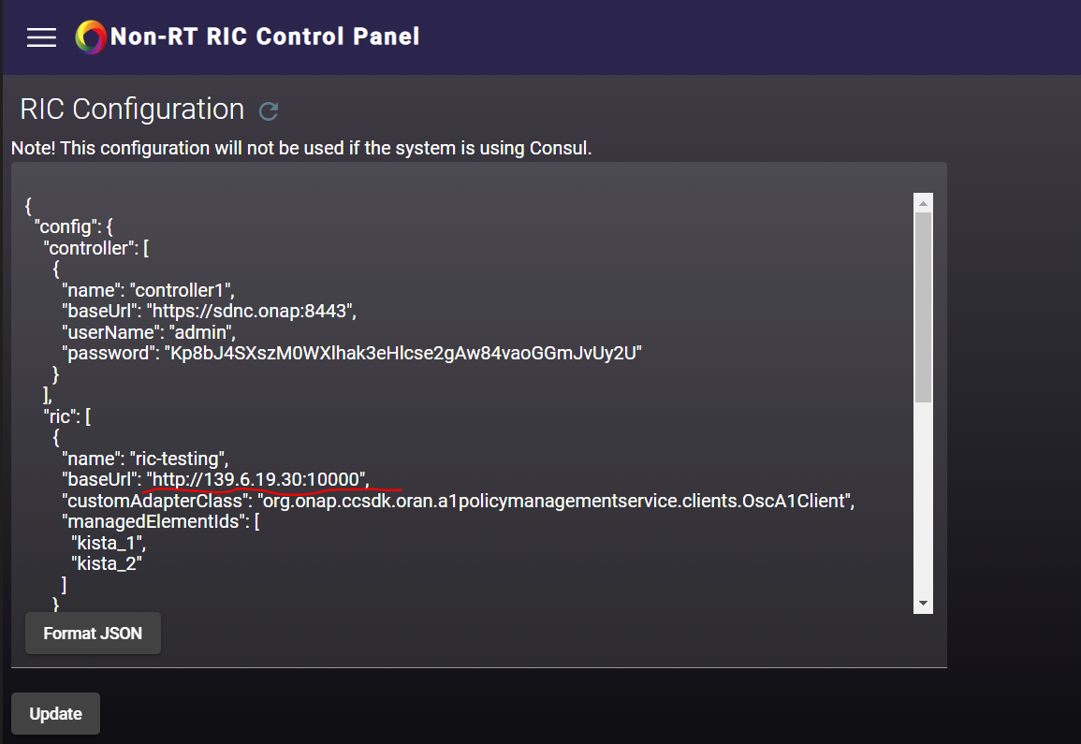
application_configuration.json

Slide 17
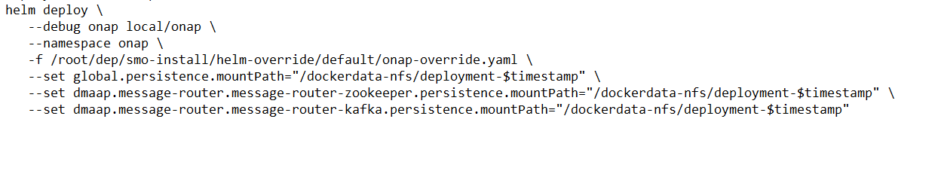
ONAP Components Installation

Slide 18
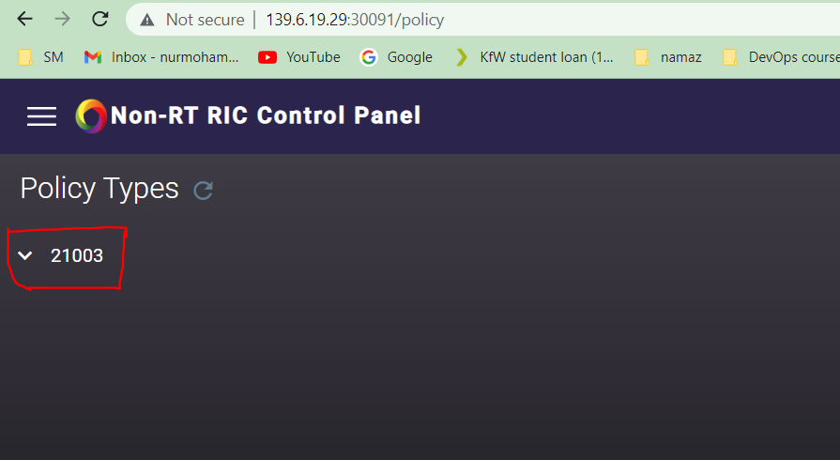
Policy Service
Replace policy_schema_ratecontrol.json file with Policy Control file.

Slide 19
Wireshark Capture

Slide 20
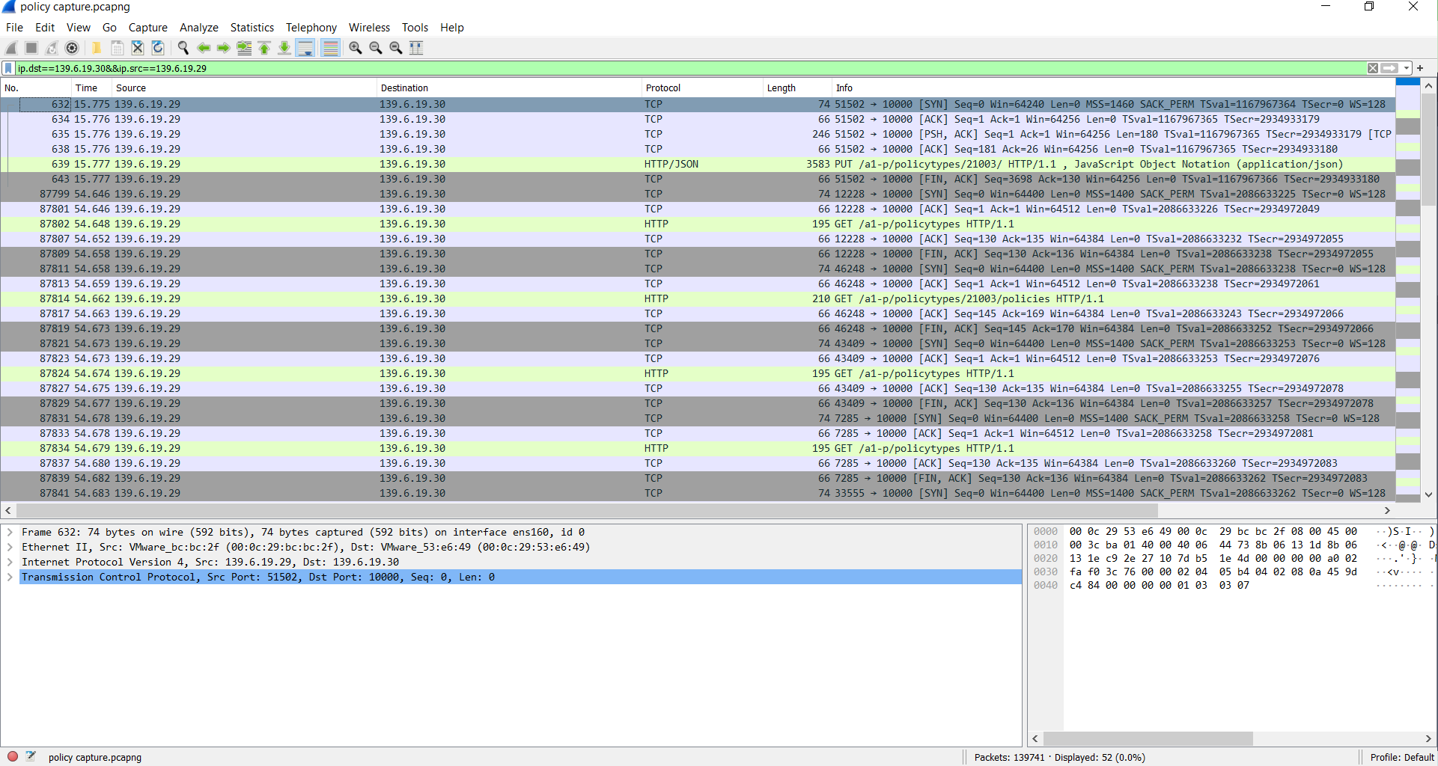

Slide 21
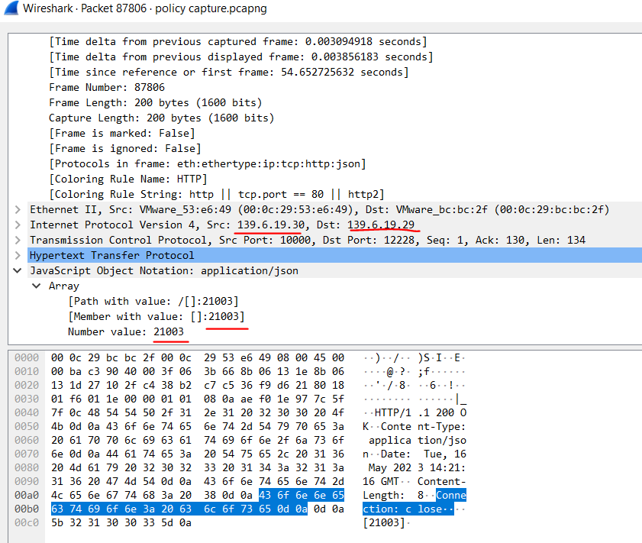

Slide 22
Future Work
Achieved Work
Deployed Non-RT RIC.
Deployed Near-RT RIC.
Established Connection Between RIC.
Created a Policy.
Further Work
Deployed other Components of O-RAN.
Connect with Achieved Work.
Connect with 5G Core Network.

Slide 23
Conclusion
Deployed RIC Components.
Estabilished Connection Between RIC Components.
Created a Policy by the Following ONAP Instructions.
Created a Policy.
Wireshark Capture.

Slide 24
References
O-RAN Alliance. ”O-RAN Alliance”. available online: https://docs.o-ran-sc.org/en/latest/architecture/architecture.html.
O-RAN Alliance. online: https://orandownloadsweb.azurewebsites.net/specifications.
O-RAN Software Community. available online: https://wiki.o-ran-sc.org/display/RICNR/Release+G+-+Run+in+Kubernetes.
O-RAN Alliance. available online: https://www.o-ran.org/specifications.
o-ran-sc.org. available online: https://docs.o-ran-sc.org/projects/o-ran-sc-it-dep/en/latest/.
O-RAN Software Community. available online: https://wiki.o-ran-sc.org/display/REL/F+Release.
rimedolabs.com. available online: https://rimedolabs.com/blog/o-ran-near-real-time-ric/.
Oliver Radwell available online: https://blog.radwell.codes/2022/07/.
linuxconfig.org. available online: https://linuxconfig.org/.
github.com. available online: https://github.com/o-ran-sc/ric-plt-a1/blob/master/docs/user-guide-api.rst.

Slide 25
QUESTIONS ?

